Slide 1
PHP
Developer’s Club
developerclub23@gmail.com

Slide 2

Title
PHP Array
PHP String Functions
Presented By:-Aniket Firke (DC Lead.)

Slide 3
An array in PHP is actually an ordered map. A map is a type that associates values to keys. This type is optimized for several different uses; it can be treated as an array, list (vector), hash table (an implementation of a map), dictionary, collection, stack, queue, and probably more. As array values can be other arrays, trees and multidimensional arrays are also possible. Explanation of those data structures is beyond the scope of this manual, but at least one example is provided for each of them. For more information, look towards the considerable literature that exists about this broad topic.
An array can be created using the array() language construct. It takes any number of comma-separated key => value pairs as arguments.
array( key => value,
key2 => value2,
key3 => value3, ...)
The comma after the last array element is optional and can be omitted. This is usually done for single-line arrays, i.e. array(1, 2) is preferred over array(1, 2, ). For multi-line arrays on the other hand the trailing comma is commonly used, as it allows easier addition of new elements at the end.

Slide 4
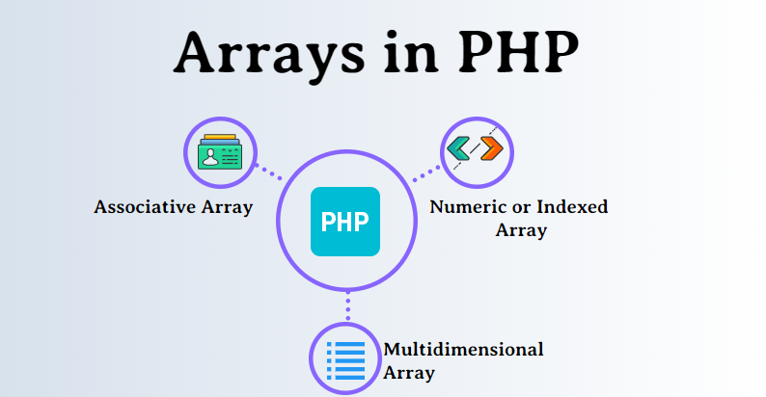
An array is a special variable that we use to store or hold more than one value in a single variable without having to create more variables to store those values.
There are different types of arrays in PHP. They are:
Numeric/Indexed Arrays
Associative Arrays
Multidimensional Arrays

Slide 5
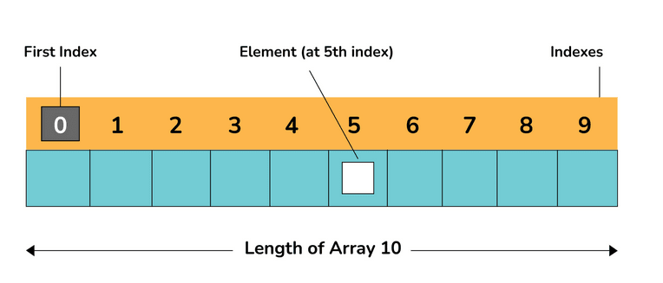
Numerical or Indexed Arrays
Numeric arrays allow us to store multiple values of the same data type in a single variable without having to create separate variables for each value. These values can then be accessed using an index which in case of numeric arrays is always a number. Note: By default the index always starts at zero.

Slide 6
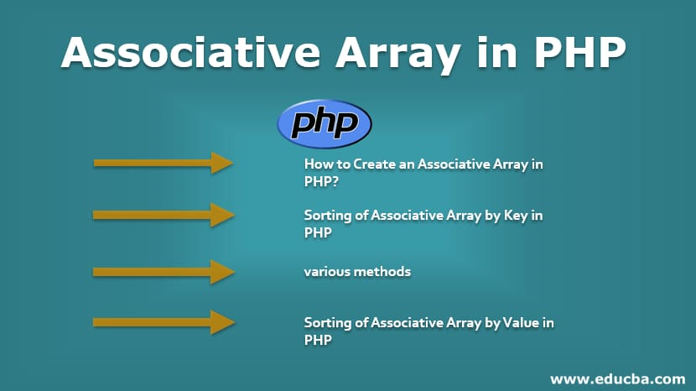
Associative Arrays
Introduction on Associative Array An array is a collection of similar and dissimilar data types. An array stores in a variable related data. We need arrays to create and store these many numbers of variables value in one variable. There are three types of an array in PHP. Numeric Arrays, Associative Arrays, and Multidimensional Arrays. An associative array is in the form of key-value pair, where the key is the index of the array and the value is the element of the array. Here the key can be user-defined. It is similar to the numeric array, but the keys and values which are stored in the form of a key-value pair. In this topic, we are going to learn about the Associative Array in PHP

Slide 7
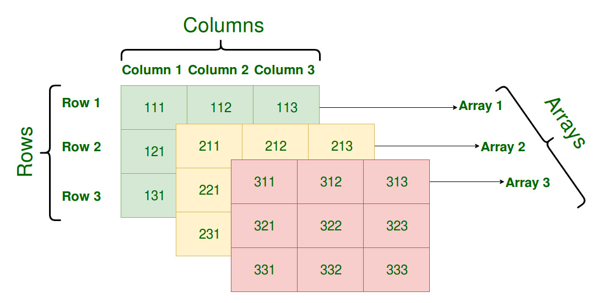
Multidimensional Arrays
A multidimensional array in PHP is an array that contains one or more arrays as its elements. In other words, it's an array of arrays. This allows you to create a more complex data structure, often resembling a table or matrix, with rows and columns. Multidimensional arrays are especially useful when dealing with tabular data or when you need to organize data hierarchically.
An array that contains one or more arrays is Multidimensional arrays. A multi-dimensional array of each element in the main array can also be an array. And each element in the sub-array can be an array, and so on. Values in the multi-dimensional array are accessed using multiple indexes.

Slide 8
String
The term "string" refers to a series of characters. PHP supports a number of data types, including strings. Alphanumeric characters are allowed in string variables. When these conditions are met, strings are generated. It is possible to create a variable and assign it to string characters. With the echo argument, using PHP Strings directly. String in PHP are language constructs that aid in the capture of terms
strlen() - Return the Length of a String
str_word_count() - Count Words in a String
strrev() - Reverse a String
str_replace() - Replace Text Within a String
According to string in php, in programm languages, string are used to modify a string or query knowledge about a string (some do both).... The length (string) is the most basic example of a string. The length of a string literal is returned by this function.

Slide 9
Functions
User Defined Functions in PHP
In PHP, functions can be written on their own in addition to the built-in PHP functions.
A function is a set of statements that can be used repeatedly in a program.
When a page loads, a feature will not run automatically.
A call to a function will cause it to be executed.
A function is a piece of code that takes another input in the form of a parameter, processes it, and then returns a value. A PHP Function feature is a piece of code that can be used over and over again and accepts argument lists as input, and returns a value
2) PHP Function Arguments
In PHP Function, arguments may be used to transfer information to functions. A variable is the same as an argument. Arguments are listed within parentheses after the function name. You can add as many arguments as you want; just use a comma to divide them.
Parameters are the information or variables contained within the function's parenthesis. These are used to store the values that can be executed at runtime. A user can enter as many parameters as he desires, separated by the comma (,) operator. During runtime, these parameters are used to accept inputs. Arguments are used while exchanging values, such as during a function call
Creating and Calling Function
The function name is any name that ends in an open and closed parenthesis.
The keyword function is often used to start a function name.
To invoke a function, simply type its name followed by the parenthesis.
A number cannot be the first character in a feature name. It can begin with a letter or an underscore.
The case of a feature name is unimportant

Slide 10
3) Passing Arguments By Reference
Arguments are generally passed by value in PHP, which ensures that the function uses a copy of the value and the variable passed into the function cannot be modified. Changes to the argument modify the variable passed in when a function argument is passed by reference. The & operator is used to convert a function argument into a reference
4) PHP Is a Loosely Typed Language
Depending on the variable’s value, PHP automatically assigns it a data form. You can do things like adding a string to an integer without making an error because the data types strictly aren't set. Kind declarations were introduced in PHP 7. This allows one to define the intended data type when declaring a method, and the strict declaration ensures that if the data type mismatches, a "Fatal Error" is thrown.
5) PHP Functions - Returning Value
This means the PHP Function can be called by its name, and when executing the function, it will return some value.
6) Setting Default Values for Passing Arguments
It is possible to specify a default argument value in the function. While calling the Function in PHP, it will take the default value if no arguments are passed
7) Dynamic Function Calls
In Dynamic Function Calls, it is possible to assign function names to variables as strings and then handle them as function names.

Slide 11

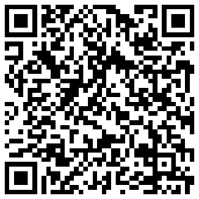
END
developerclub23@gmail.com

